Slide 1
Data-Driven strategies for baby fashion startup
Unlocking opportunities in the baby fashion market
1/32

Slide 2
Agenda
Introduction
Data exploration
Can we find something interesting in this data?
Key insights
Evaluation & next steps
2/32

Slide 3
Introduction
We have a dataset containing U.S. baby names from 1880. to 2014. (national and state level)
Our main goal is to uncover meaningful insights into U.S. baby name trends to:
Explore markets for startup expansion
Lay the groundwork for a persionalized recommendation system to help parents choose a name for their baby that feels just right
3/32

Slide 4
Data exploration: key charts & insights
Birth trends over time by state
Birth trends in the last 10 years
Gender ratio of newborns
Most popular baby names over time
Most popular baby names in the last 10 years
4/32

Slide 5
Birth trends across all states
5/32

Slide 6
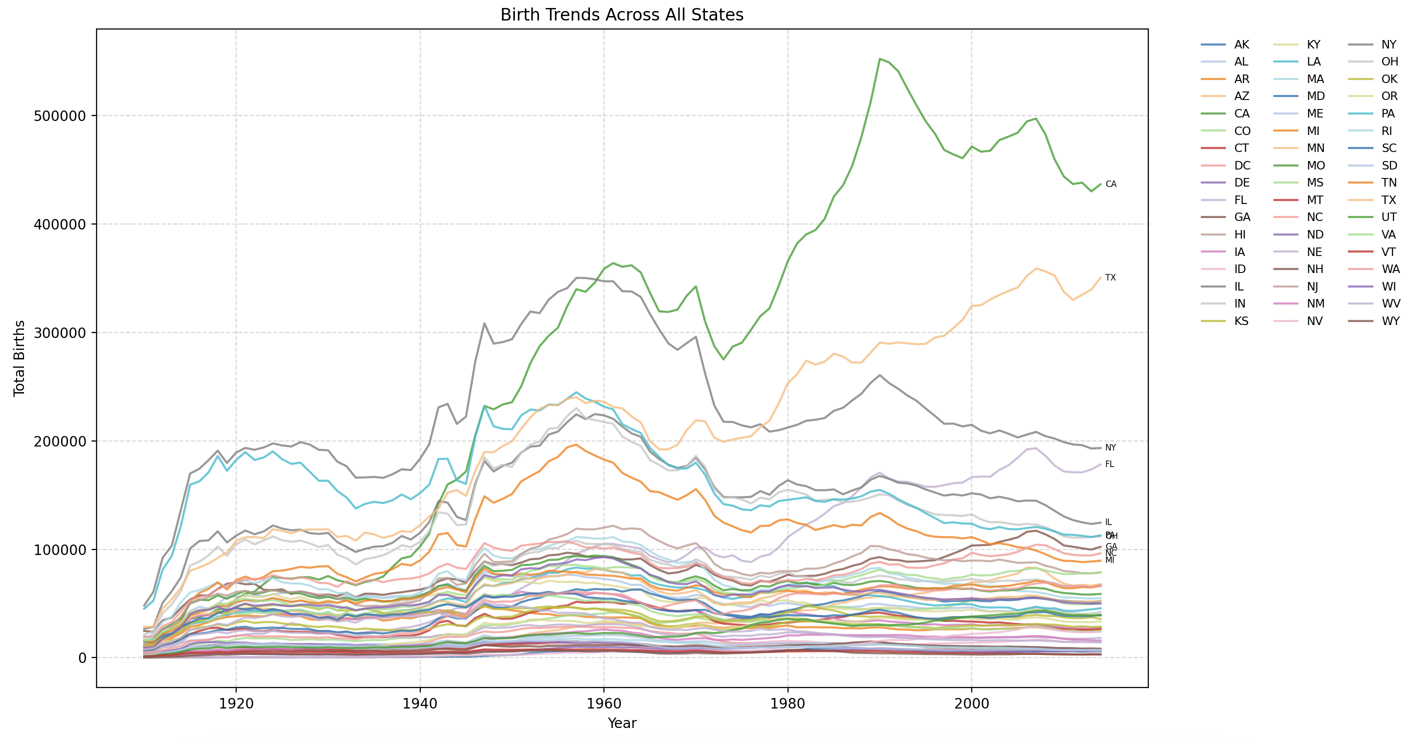
6/32

Slide 7
- The overall birth trend has shown continuous growth over time, aligning with general population increases
- Certain states stand out in terms of newborn numbers: California (CA), Texas (TX), and New York (NY), followed by Illinois (IL), Pennsylvania (PA), and Ohio (OH)
- These insights confirm high birth rates in key regions, but the long historical scope (1880 onward) makes them less actionable for current business decisions
7/32

Slide 8
Birth trends across all states – last 10 years
8/32

Slide 9
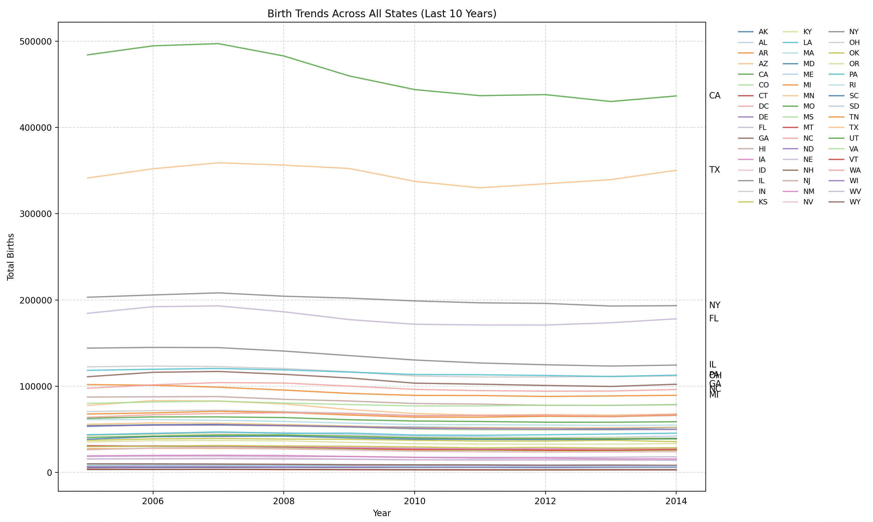
9/32

Slide 10
- In recent years, the number of newborns has remained relatively stable
- Notably, California (CA) shows a decreasing trend, whereas other leading states maintain consistent birth rates
- This stability suggests a reliable market for baby-related businesses, making high-birth states attractive locations for launching and expanding the brand’s personalized clothing line
10/32

Slide 11
Total male and female births per state
11/32

Slide 12
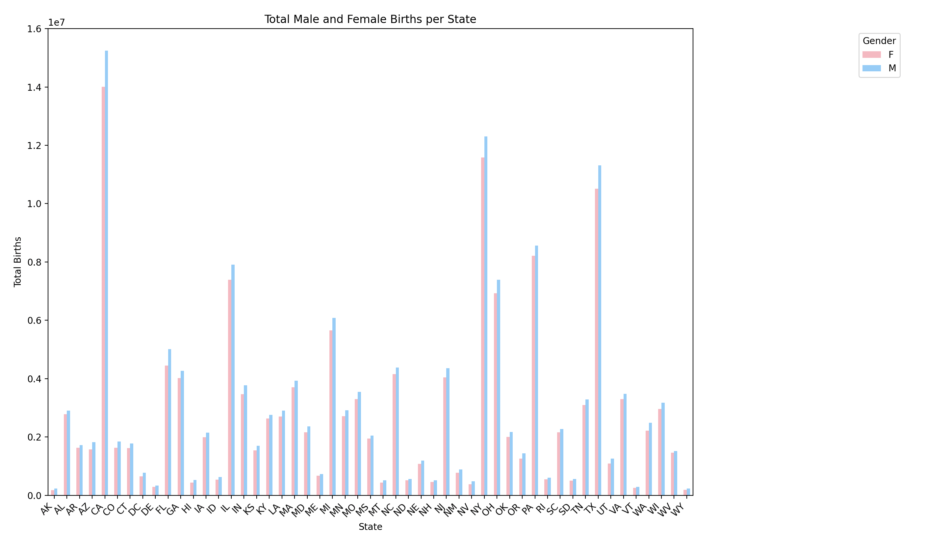
12/32

Slide 13
- States with the highest birth counts remain consistent across the board
- There is a slight predominance of baby boys over baby girls
- Business Implication: This ratio can inform inventory planning and marketing strategies, ensuring the startup’s product line is balanced and aligned with the demographic distribution
13/32

Slide 14
Top 10 names over time – by gender
14/32

Slide 15
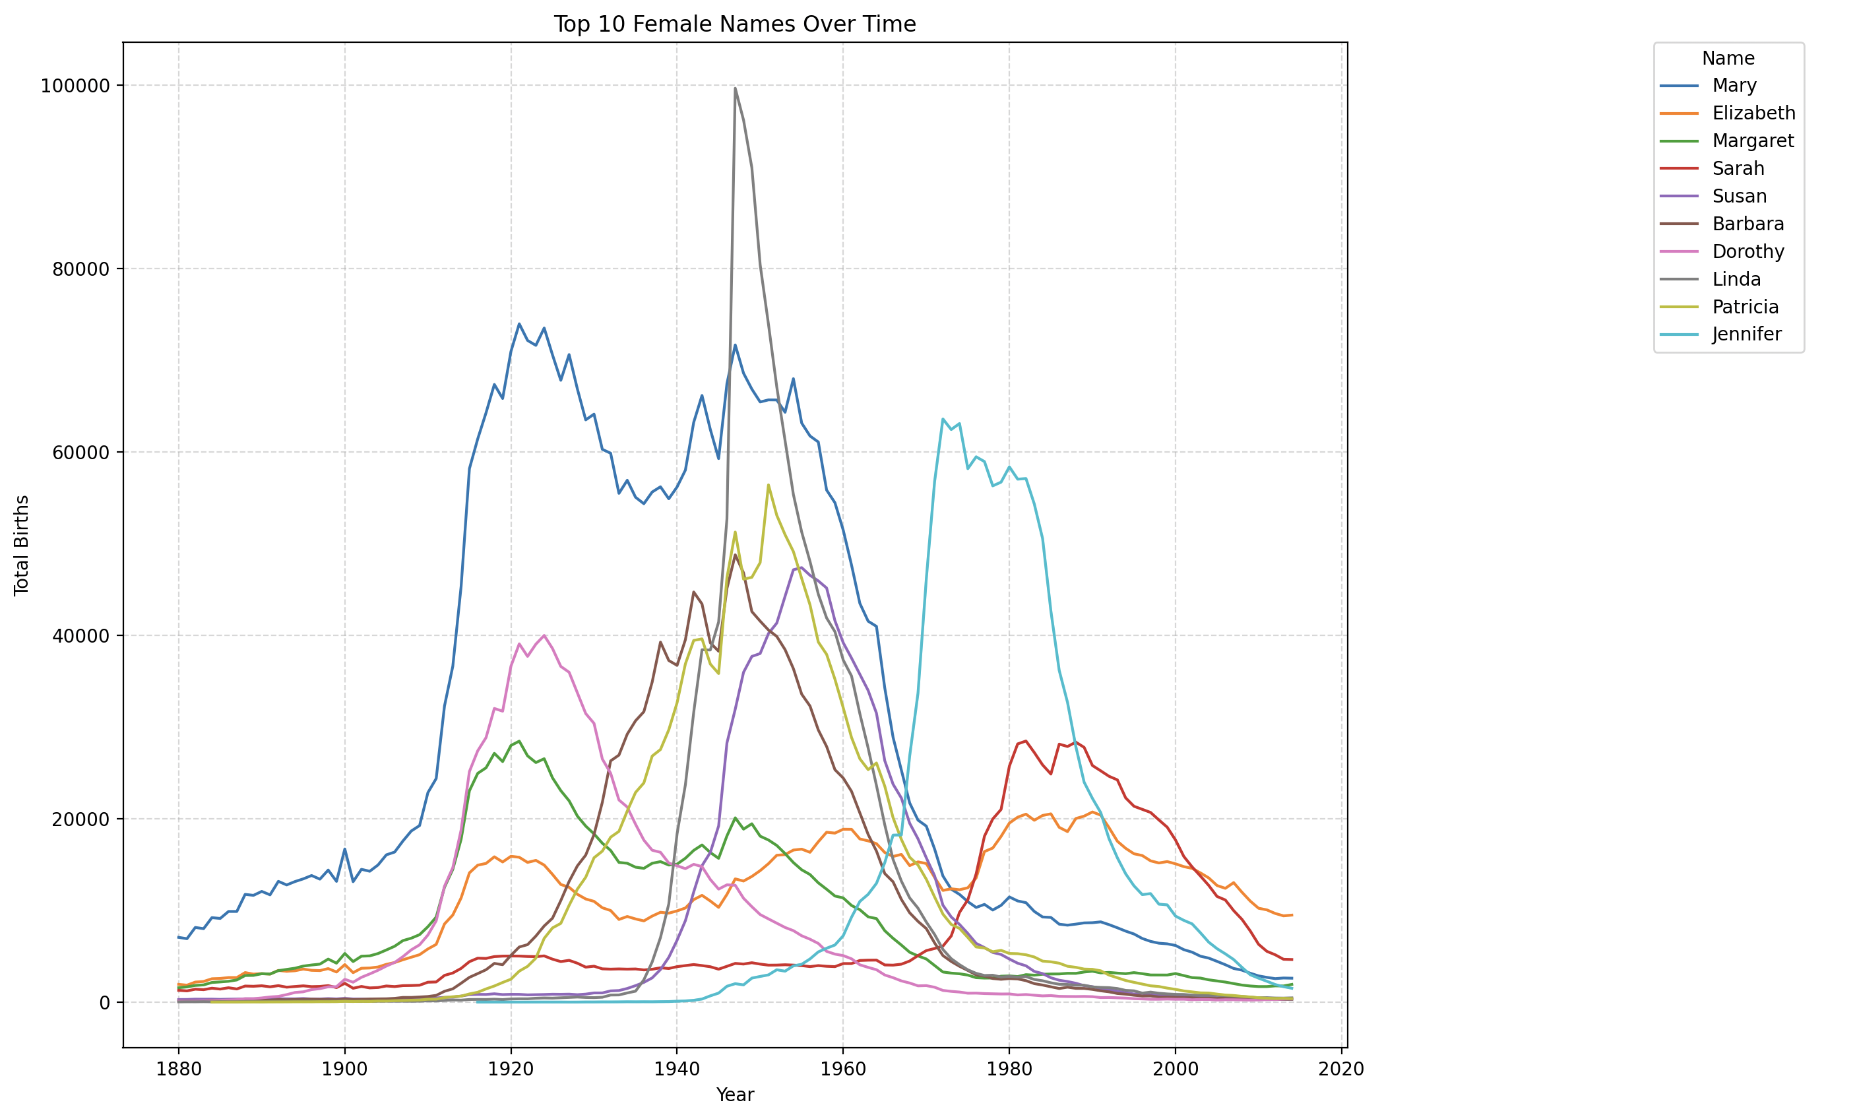
15/32

Slide 16
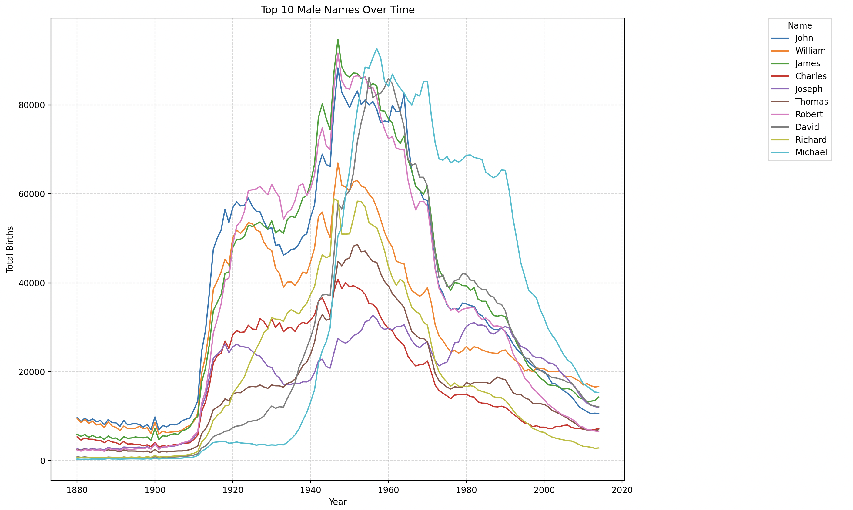
16/32

Slide 17
Findings: Most popular baby names over time
Many historically popular names reached their peak in the past but have become less common recently, indicating shifting naming preferences
This suggests that relying solely on historically top-ranked names may not align with current trends
Business Implication: By understanding these trends, the startup can focus on names that are currently resonating with modern parents when designing personalized products
17/32

Slide 18
Top 10 names in last 10 years – by gender
18/32

Slide 19
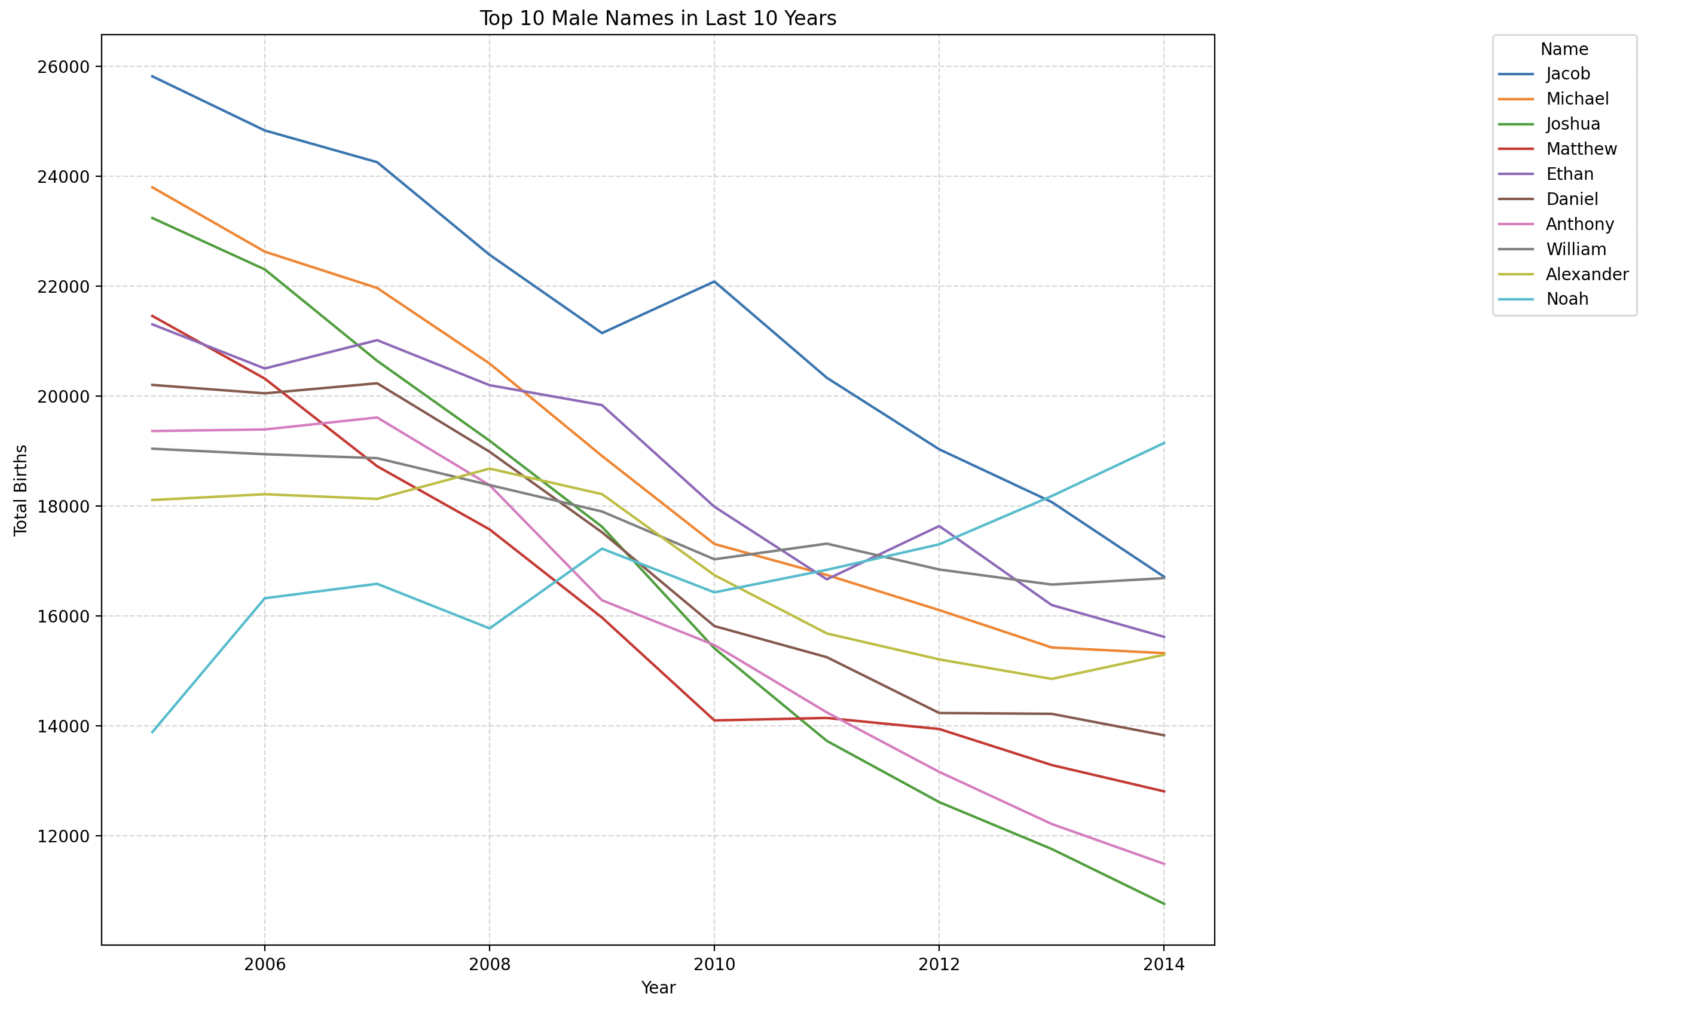
19/32

Slide 20
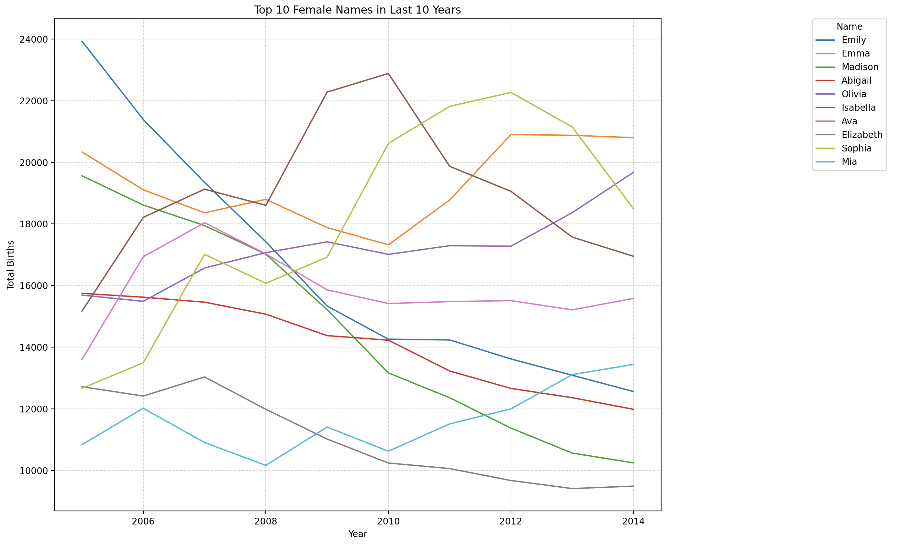
20/32

Slide 21
Findings: Most popular baby names in last 10 years
Most top names in the last decade have seen a decline in usage over time
Few names have remained stable, indicating consistency in parental preferences
Noteworthy Observation: The male name Noah is the only one that showed a continuous increase in popularity
Business Implication: This insight allows the startup to align its product offerings with modern naming trends by prioritizing currently trending names such as Noah, ensuring the brand remains relevant and appealing
21/32

Slide 22
NEXT QUESTION
Could we group states by identifying similarities in the names parents choose?
22/32

Slide 23
Could we group states by identifying similarities in the names parents choose?
The answer is – yes
How it works?
We compared each name’s popularity in a state to its national average
Then, we identified “significant” states where certain names are especially popular
Using those findings, we grouped states with similar naming trends—helping pinpoint where a successful strategy in one state might also work in another
23/32

Slide 24
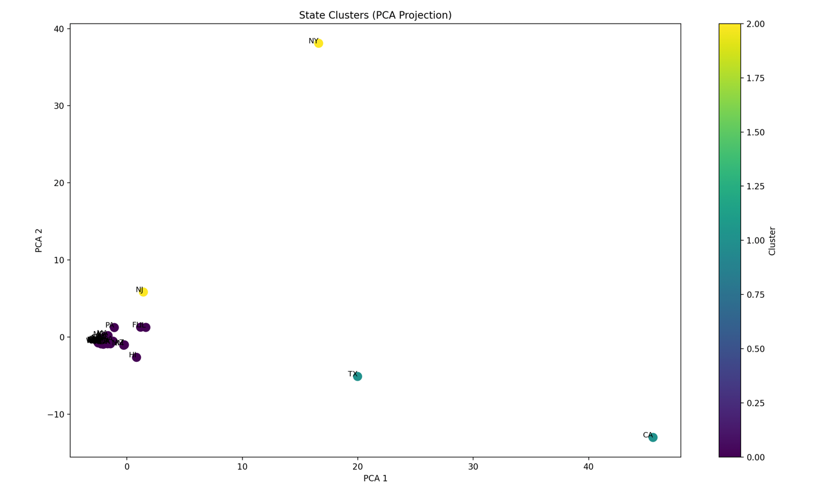
24/32

Slide 25
We divided states into three main clusters based on similar naming trends:
Cluster 1: Texas & California
Cluster 2: New York & New Jersey
Cluster 3: All other states
By recognizing these clusters, we can target marketing and expansion efforts more effectively
If a strategy works in one state, it’s likely to succeed in others within the same cluster
25/32

Slide 26
Question: What if we could make choosing the perfect name easy for parents?
What if they know they prefer a name that's short, very rare, and not popular—but they can’t think of one?
Or what if they like the name Sophia, but don't want to use it because it reminds them of someone or is just too common?
We can offer two recommendation systems to help parents choose a name: one based on specific preferences and another focused on how the name sounds
26/32

Slide 27
Recommendation system based on parents’ preferences
Key idea: We enriched our dataset with extra features—name length, rarity, unisex status, and popularity trend—so the system can match parents’ preferences more accurately
How it works: We compare each name’s attributes with the user’s desired preferences, then suggest the best matches
Example: If parents want a long, rare, unisex name with a decreasing popularity trend, our system quickly provides tailored suggestions, sparing them the time of searching through endless name lists
Suggested names: Zechariah, Shaughnessy, Pressley, Theodore, Kearston, Johnelle, Chestine, Reginald, Donyelle, Marquette
27/32

Slide 28
Recommendation system based on phonetic name matching
Key Idea: If parents have a name they like but don’t want to use it (maybe it’s too popular or has an unwanted association), our phonetic approach finds alternatives that sound similar
How it works: We use a phonetic algorithm that groups names by how they sound
Example: If someone likes “James” they might discover “Jonas” “Junius” or “Johannes” preserving the overall sound while choosing a different name
28/32

Slide 29
CONCLUSION & next steps
29/32

Slide 30
Key Insights
Market expansion & naming preferences
High-birth states (e.g., TX, NY) could be prime for expansion
Clustering reveals similar naming trends, helping replicate successful strategies across clustered states
Evolving naming trends & recommendation system
Traditional names are declining; modern names (e.g., “Noah”) are on the rise
A recommendation system (preference-based + phonetic) can offer relevant names
Tailored marketing & future growth
Focus on high-birth or similar states for efficient market entry
Leverage data insights to remain competitive in baby fashion industry
30/32

Slide 31
Evaluation & next Steps
Strengths
Data-driven targeting of high-potential markets
Effective clustering for regional similarity
Integration of evolving trends (historical + phonetic insights)
Dual-purpose data use (business expansion + customer engagement)
Areas for improvement
Update dataset with more recent information
Validate the link between naming trends and clothing purchases
Account for broader cultural/socioeconomic factors in clustering
Enrich the recommendation system with additional demographics
Overall evaluation
A data-based roadmap for market expansion and personalization
Future enhancements (more data, deeper analysis) can strengthen competitive advantage
31/32

Slide 32
Thank you
QUESTIONS ?
32/32

